Slide 1

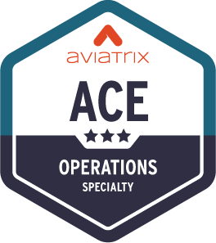
FireNet Operations

Slide 2
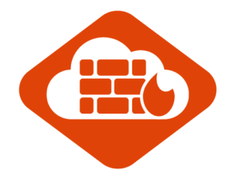




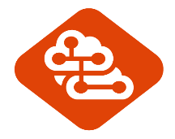


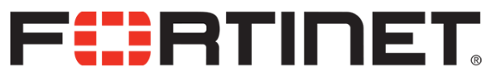


Aviatrix Transit Firewall Network (FireNet)
Scale out, multi-AZ FW deployments, bootstrapping
VPC/VNET
VPC/VNET
VPC/VNET
VPC/VNET
Automated route management, segmentation, and security policies
Aviatrix ActiveMesh
Deep visibility and operational capabilities
FireNet
Transit
Repeatable across regions and clouds
IPSec
VPN
Aviatrix
Controller
Direct Connect/
Express Route
Bring Your
Own Appliance

Slide 3





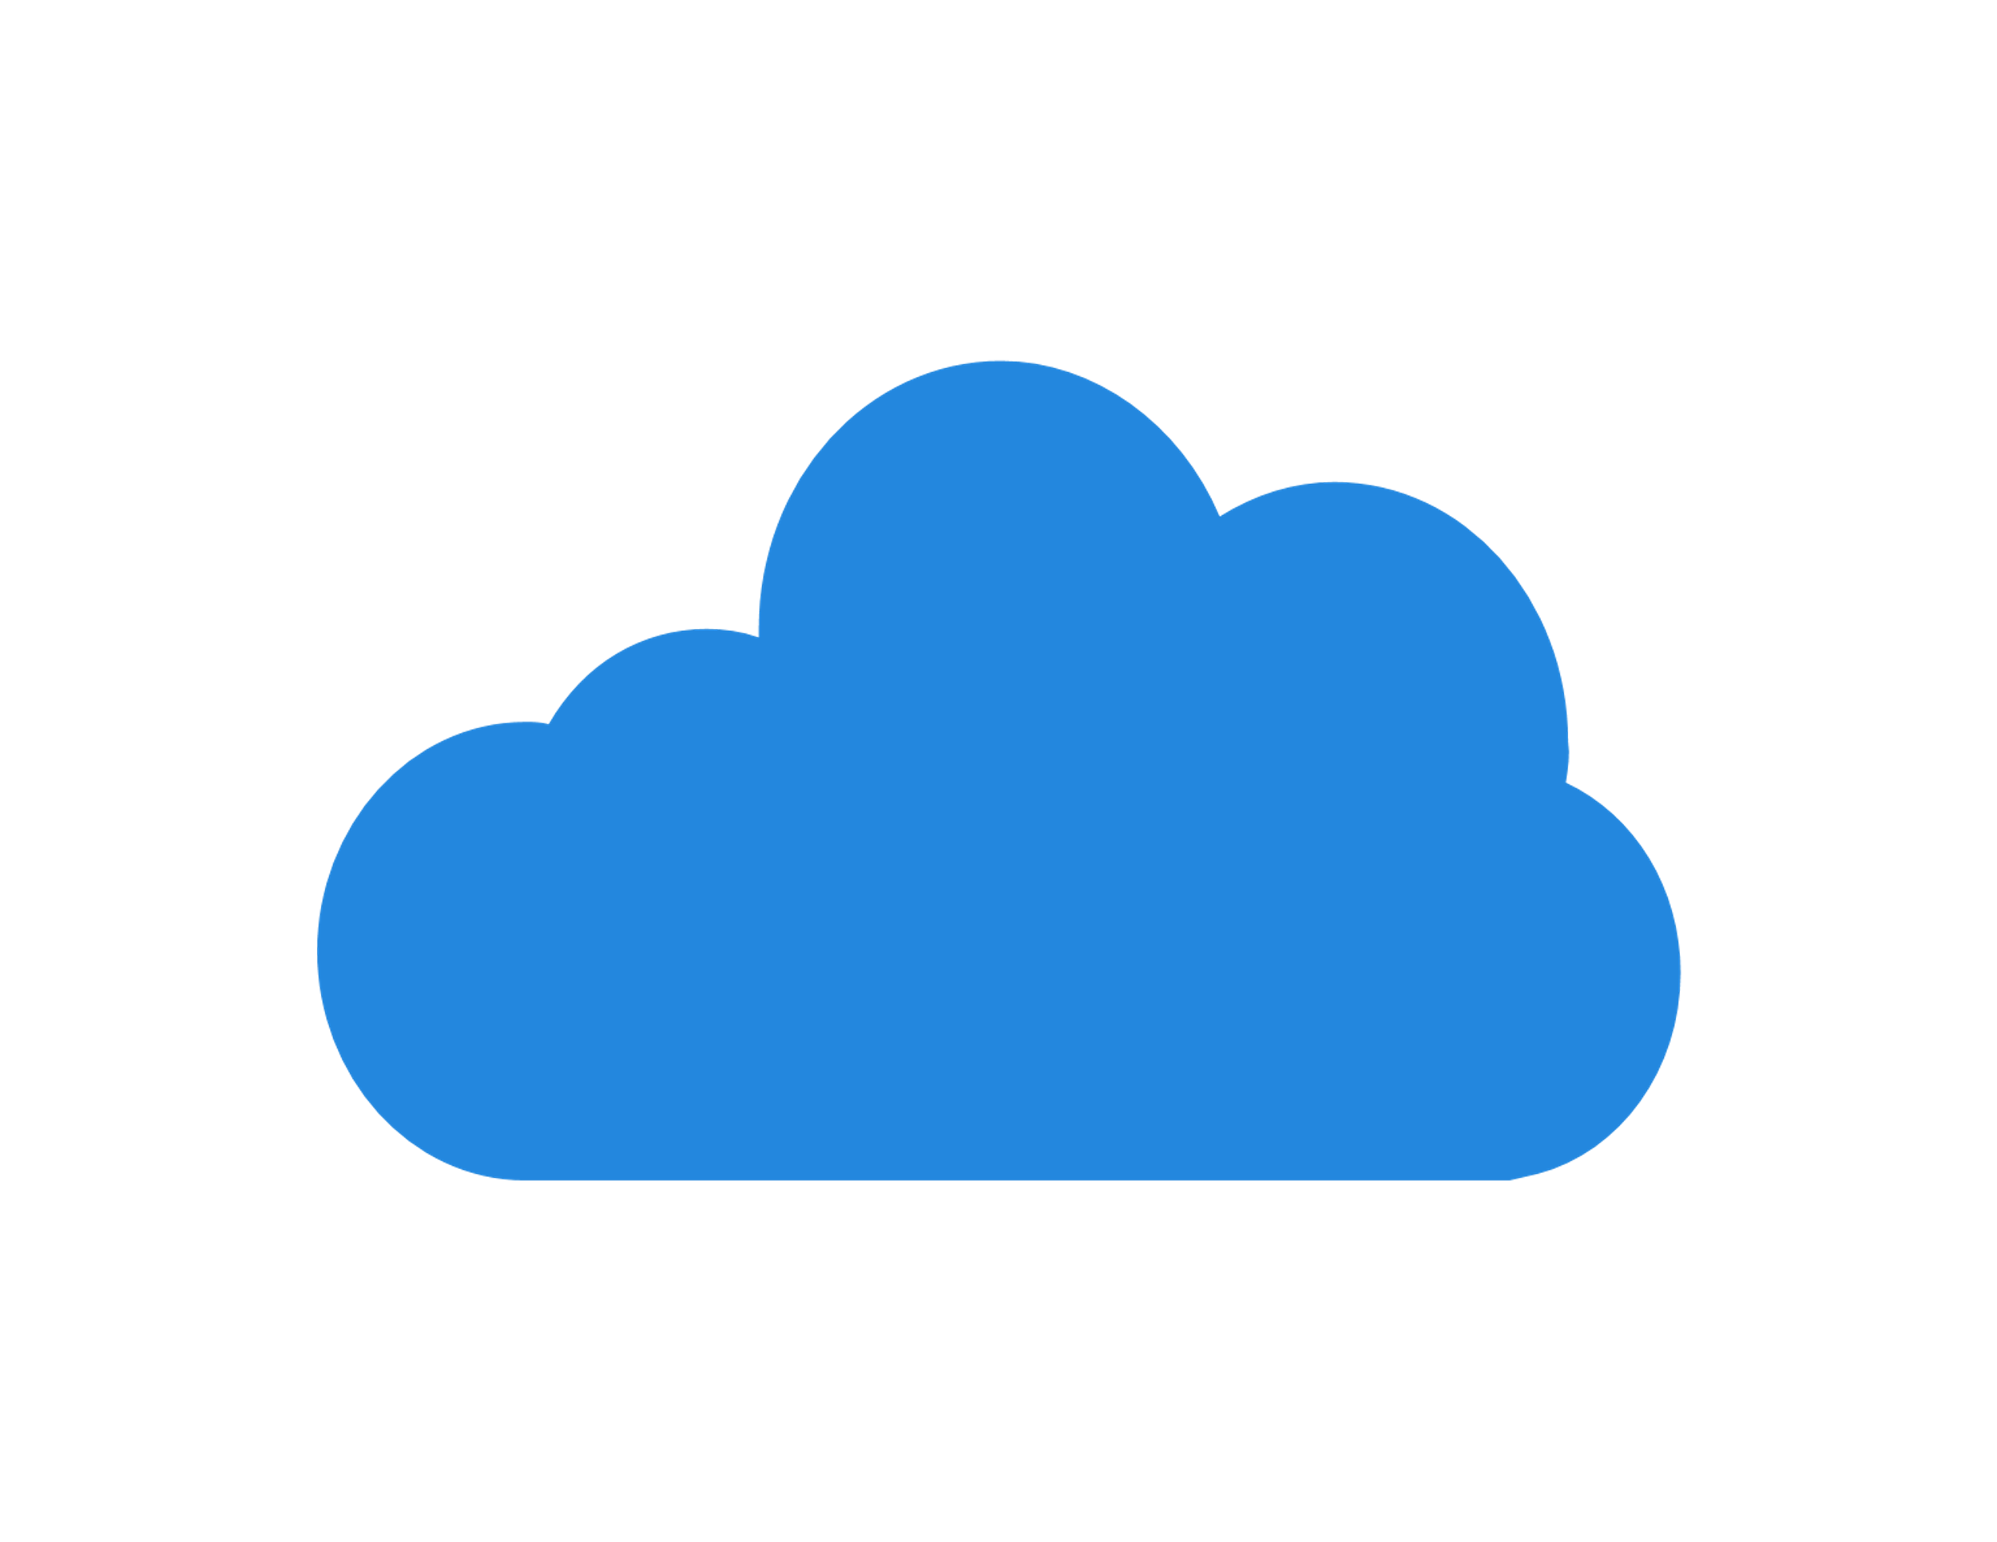
FireNet Architecture Options (Azure Example)
Each firewall set can scale independently based on need
Single HUB FireNet
Dual HUB FireNet
RFC1918
0/0
RFC1918 & 0/0
HUB
HUB1
HUB2
Internet
Internet
3

Slide 4

FireNet Packet Walk – AWS Example
A Host 1.10 communicating with 2.20 with VPC A inspected via FireNet
The local route table for 1.10 has RFC1918 routes pointed to its local gateway.
The local Aviatrix spoke gateway will ECMP traffic with 5-tuple hash to one of the Aviatrix Transit Gateways.
The Aviatrix Transit Gateway receiving the flow will check inspection policy to determine if either source or destination requires FireNet. If a match, traffic is redirected to the firewall in the same AZ.
The Firewall selected will process the packet and send the traffic back to its defined Transit Gateway.
The Aviatrix Transit Gateway will receive the processed packet and forward (ECMP) with 5-tuple hash towards the destination spoke.
The destination spoke gateway will receive the traffic and route the traffic out its local interface to the VPC route table. Note that this GW may not be in the same AZ as the destination instance.
The destination will receive the original traffic and see this as native VPC communication flow.
VPC A
VPC B
1
1.10
7
2.20
2
6
3
5
Aviatrix Transit tracks the health of Firewall
4

Slide 5
FireNet Packet Walk – AWS Example
Return Flow: 1.10 communicating with 2.20 with VPC A inspected via FireNet
The local route table for 2.20 has RFC1918 routes pointed to its local spoke gateway for return traffic.
The local Aviatrix spoke gateway will ECMP traffic with 5-tuple hash to one of the Aviatrix Transit Gateways.
The Aviatrix Transit Gateway receiving the traffic will pass the traffic to the the same FW which handled the initial flow to maintain symmetry.
The stateful Firewall will process the return traffic and route the traffic back to its designated gateway.
The Aviatrix gateway will ECMP traffic with 5-tuple hash to one of the destination spoke gateways.
The destination spoke gateway will route this traffic out its local interface to the native VPC route table.
The original source will receive the return traffic and see this as native VPC communication flow.
VPC A
VPC B
7
1.10
1
2.20
6
2
5
3
4

Slide 6

FireNet Packet Walk – Azure Example
A Host 1.10 communicating with 2.20 with VNET A inspected via FireNet
The local route table for 1.10 has RFC1918 routes pointed to its local gateway.
The local Aviatrix spoke gateway will ECMP traffic with 5-tuple hash to one of the Aviatrix Transit Gateways.
The Aviatrix Transit Gateway receiving the flow will check the inspection policy to determine if either source or destination requires FireNet. If a match, traffic is redirected to Azure ILB.
The Azure ILB will perform a 5-tuple hash to send the traffic to one of the backend pool members.
The Firewall selected will process the packet and send the traffic back to its defined Transit Gateway.
The Aviatrix Transit Gateway will receive the processed packet and forward (ECMP) with 5-tuple hash towards the destination spoke.
The spoke gateway will receive the traffic and route the traffic out its local interface to the Azure VNET route table.
The destination will receive the original traffic and see this as native Azure communication flows.
VNET A
VNET B
1
1.10
8
2.20
2
7
3
6
4
ILB tracks the health of Firewall
Health check is not configurable in Azure via Controller
5

Slide 7
FireNet Packet Walk – Azure Example
Return Flow: 1.10 communicating with 2.20 with VNET A inspected via FireNet
VNET A
VNET B
The local route table for 2.20 has RFC1918 routes pointed to its local spoke gateway for return traffic.
The local Aviatrix spoke gateway will ECMP traffic with 5-tuple hash to one of the Aviatrix Transit Gateways.
The Aviatrix Transit Gateway receiving the traffic will pass the traffic to the ILB. The gateway will PBR the traffic back to the ILB for FireNet.
The Azure load balancer will hash the traffic however, the reverse flow hash will match the initial flow to ensure symmetry.
The stateful Firewall will process the return traffic and route the traffic back to its designated gateway.
The Aviatrix gateway will ECMP traffic with 5-tuple hash to one of the destination spoke gateways.
The destination spoke gateway will route this traffic out its local interface to the native Azure route table
The original source will receive the return traffic and see this as native Azure communication flows
8
1.10
1
2.20
7
2
6
3
4
5

Slide 8

FireNet in Azure – 3 States
Steady State
Each Firewall is associated to an Aviatrix Transit GW
Firewalls are part of the LB backend pool
UDR in each Firewall subnet point to a single gateway
Firewall Failure State
Each Firewall is associated to an Aviatrix Transit GW
Firewalls are part of the LB backend pool
If Firewall fails, LB will remove the firewall from the backend pool
Gateway Failure State
Each Firewall is associated to an Aviatrix Transit GW
UDR in each Firewall subnet point to a single gateway
If Gateway fails, an API call is made to update the UDR to point to the other healthy gateway
subnet
subnet
subnet
subnet
subnet
subnet
Aviatrix
Controller

Slide 9
Tools for Operating your FireNet

Slide 10
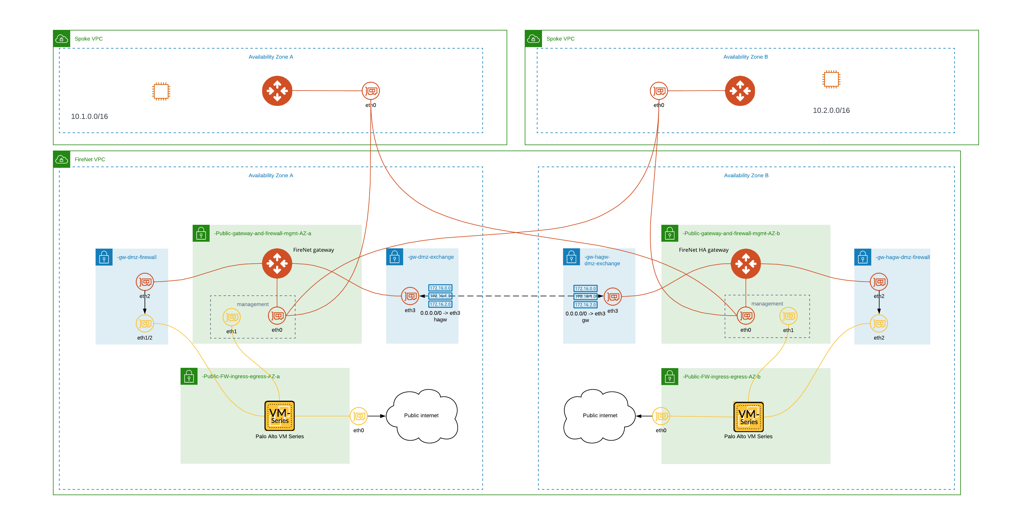
FireNet – Under the hood

Slide 11
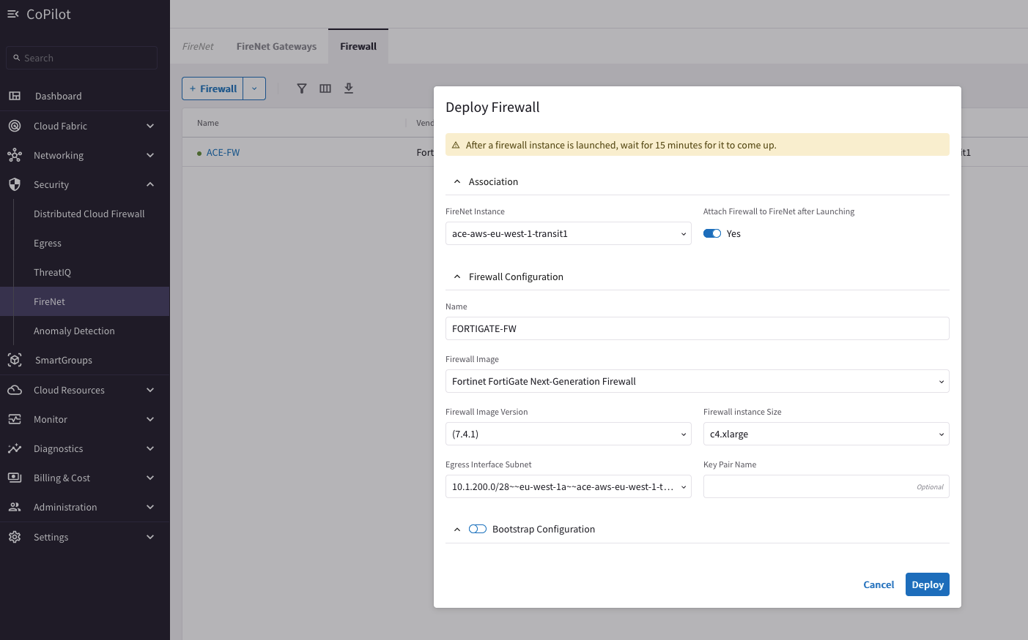
Firewall Deployment Workflow
PATH: Security > FireNet > Firewall
Select the Transit FireNet GW
Select the Firewall Image (requirement: Subscribe to the firewall instance from the Marketplace)
Firewall Image Version
Firewall Instance Size
Egress Interface Subnet
Management Interface Subnet (Palo Alto/AWS only)
Bootstrap Configuration (optional)
Supported Firewall Vendors: Palo Alto VM-Series, Check Point CloudGuard, Fortinet FortiGate, BYOA
Panorama is also supported as a firewall manager for Palo Alto VM-Series.

Slide 12
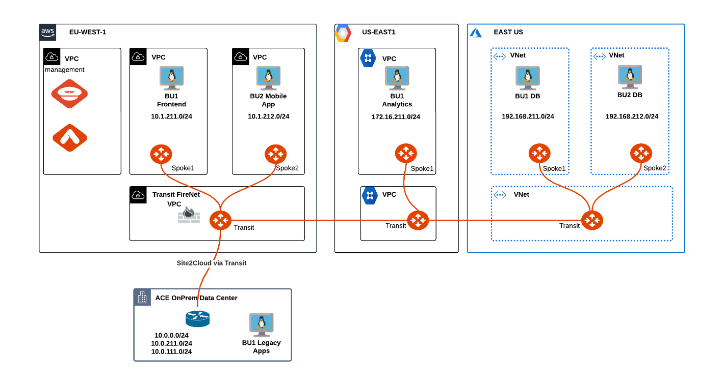
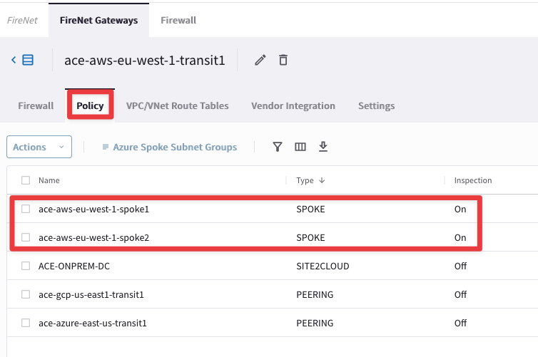

Inspection Policy
On the FireNet Policy tab you can add or remove inspection policies for the selected FireNet. When an inspection policy is added the traffic related to the Transit FireNet’s attachment (Spoke/Edge gateway, peered Transit, Site2Cloud connection) is inspected by the firewall within the selected Transit FireNet.
By default, FireNet inspects ingress and east-west traffic only.

Slide 13
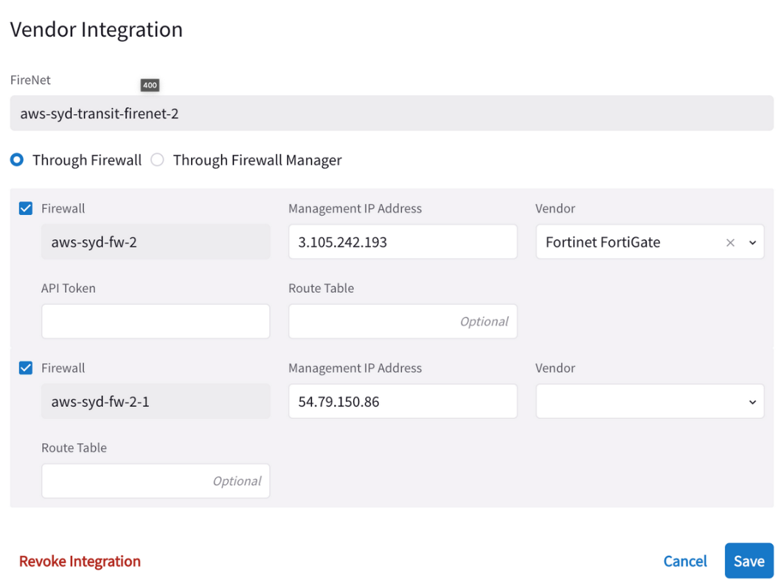
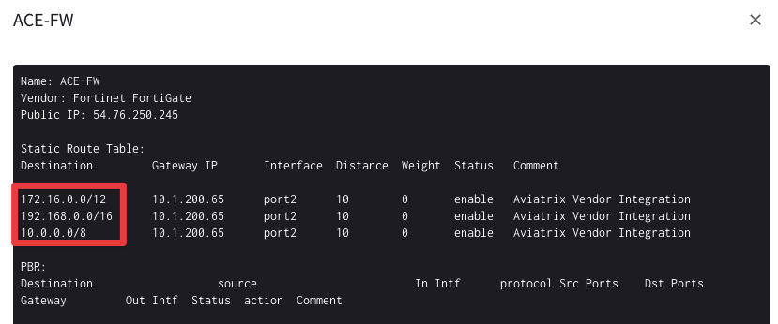
Vendor Integration
The Vendor Integration function allows the Controller to log into a firewall or firewall manager and change the route table on the firewall to program the routing for FireNet, or to change routing if a gateway in FireNet fails.
Vendor Integration allows to configure the RFC 1918 routes and non-RFC 1918 routes on the Vendor’s firewall instance

Slide 14
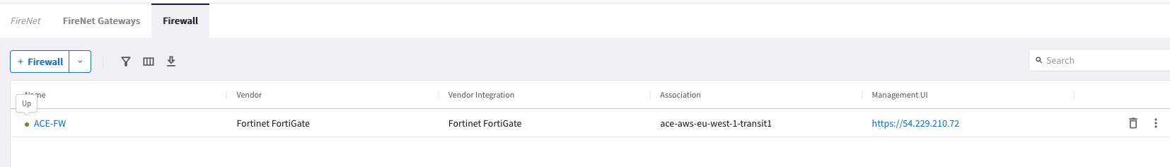
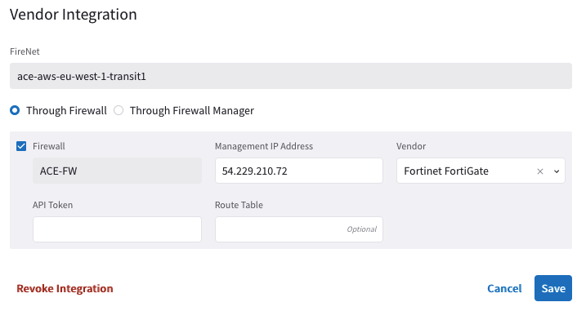
Information to Collect / Checklist
Make sure Aviatrix sees the FW as “healthy”
For Ingress: Check if any native LB deployed in front of the FWs is also configured correctly
Vendor Integration: make sure the controller can reach the FW
Nothing preventing the communication, NACLs, NSGs, SLs, etc.
Make sure there are no “uncommitted” pending changes on the FW
Make sure your Network Domain/Spoke is configured for inspection
Make sure Connected Transit is enabled (if necessary)
Make sure your Spoke is attached to Transit
Verify Spoke and Transit GW routes in MULTI-CLOUD TRANSIT > List > Details

Slide 15
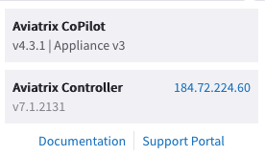
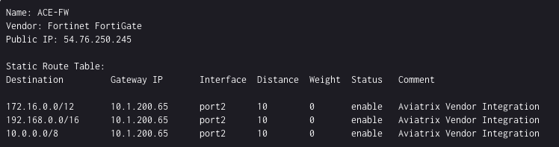
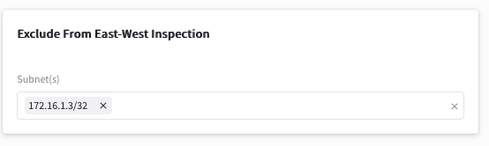
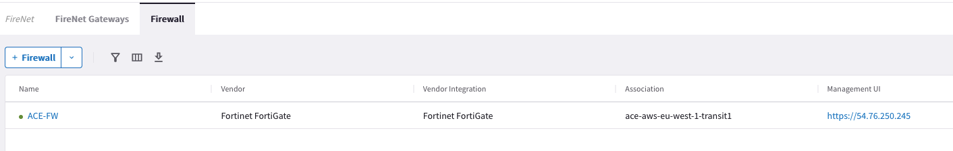
Information to Collect - Checklist for the Support Team
Aviatrix Controller version
Firewall Vendor
Transit FireNet: Inspection Policy
Is the Spoke VPC/VNet supposed to be Inspected at all?
E/W Traffic inspection enabled?
Egress Traffic inspection enabled?
Ingress Traffic enabled and working?
Exclude list created for CIDR/IP from being inspected by FireNet?
Is there any automation running every day / hour / ?

Slide 16
Next: Lab 3 FireNet - Interface Lab 4 FireNet - Routes

